Slide 1
IaaS Masterclass ARM, Virtual Machines and Networking
William Eastbury
Technical Evangelist
Notes:
We will talk about
Azure Resource Manager,
Desired State Configuration,
Virtual Networking,
Storage Performance
and VM Scale Sets

Slide 2
“Life is really simple, but we insist on making it complicated.”
“Life is really simple, but we insist on making it complicated.”
Confucious
Notes:
The theme for the afternoon will be.

Slide 3
But First… Please fill out your Evaluation Forms !

Slide 4
Azure Resource Manager Deploying infrastructure
Notes:
The infrastructure for your application is typically made up of many components – maybe a virtual machine, storage account, and virtual network, or a web app, database, database server, and 3rd party services.
You do not see these components as separate entities, instead you see them as related and interdependent parts of a single entity. You want to deploy, manage, and monitor them as a group.
DevOps Deployment Automation - Requires a faster, more flexible deployment approach than the old ASM gateway and powershell could provide – ASM PowerShell can be very complex to define and troubleshoot.

Slide 5
ARM vs ASM
ASM - Programmatic infrastructure deployment
"Dear Azure, here's a list of everything I want you do, in excruciating detail“
ARM - Declarative end-state deployment
"Dear Azure, here's what I want it to look like - go, make it happen"
Notes:
ARM does desired-state deployment of resources. It does not do desired-state configuration inside these resources (e.g., VMs), although it can initiate the process of desired-state configuration.
Faster Deployments – ARM can deploy in true parallel as compared to semi-sequential in ASM
RBAC is fully integrated with AAD – and is a long-requested feature.
Resource-provider model is intended to be fully extensible.
Common interface for Azure and Azure Stack – When Azure Stack is released, same API model for on-premises and Cloud

Slide 6
Automating Deployment with PowerShell DSC Deploying ‘cattle’, not ‘pet’ servers.
Notes:
Show the DSC pull Server.

Slide 7
“Where the senses fail us, reason must step in.”
Galileo
Notes:
Speak to speed of service development in IaaS as well.
Speak about cattle and pets – as we move to the cloud, we need to deploy ‘disposable servers’

Slide 8
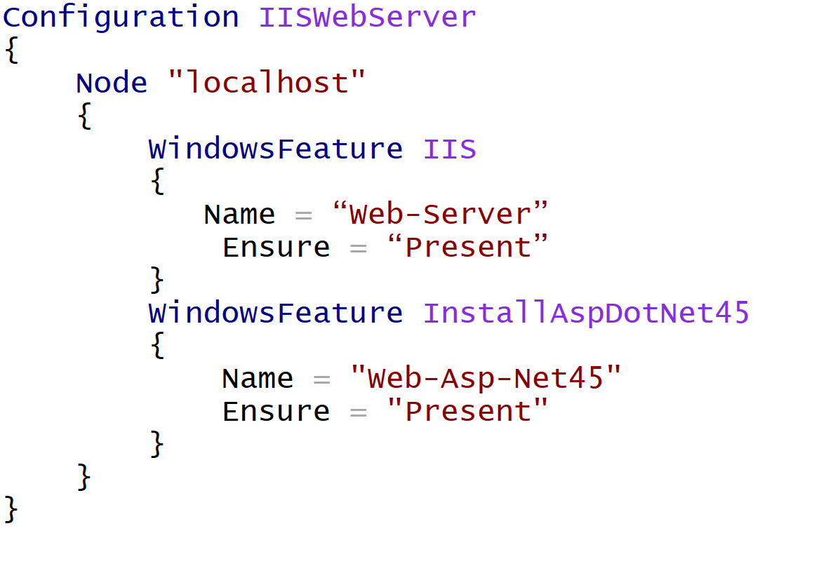
PowerShell DSC Script – Install IIS and ASP.Net
Notes:
Then open portal and demo

Slide 9
DEMO 1: PowerShell DSC Deployment

Slide 10
Networking Choices Connecting your machines and virtual networks together

Slide 11
VM Networking Options
Classic – Standalone VM or Virtual Network
ARM – Virtual Network ONLY

Slide 12
Connectivity / Networking Options
Virtual Private Network Gateway
Consider On-Premise Device regarding Static and Dynamic vs High-Performance VPN gateways
SSL Endpoint
ExpressRoute Connections
VNet – VNet Peering
Hybrid Connection Options (TCP Bridge / Service Bus Based A.K.A. BizTalk Hybrid Connections, Service Bus Relay)
Notes:
Comment on Cisco ASA Static only

Slide 13
IaaS Networking - Remember
Use Network Security Groups to lock down your (multiple) subnets.
Multicast traffic is not supported.
Can I just expose an SSL secured endpoint? (VPN / ExpressRoute connections will expose EVERYTHING by default behind the gateway, lock them down with an NSG ?)
ExpressRoute connections have significantly lower connection latency than VPN
VPN Transit routing is only supported in some circumstances, with some circumstances
VNet peering can be used to connect VNets together without a VPN gateway.
Consider Gateway / FE appliances such as a Barracuda, F5 or Application Gateway

Slide 14
Show and Tell: VNet Peering

Slide 15
Performance Choices - VM Choosing the right Virtual Machine and Storage Combination

Slide 16
What do you need ?
Cheap, cost effective compute ?
High # of CPU Cores ?
High CPU Clock Speed per core ?
High Network Cluster Bandwidth – maybe InfiniBand ?
High Memory Allocation ?
Stupidly High Memory Allocation (400GB>) ?
Fast SSD Scratch temporary storage ?
Extreme number of Local IOPS ?

Slide 17
A Series
Comes in 2 flavours, Basic and Standard.
Temporary Drive backed by HDD included with VM
Cost-effective commodity compute – ‘vanilla’ Azure VMs.
From: 1-core / 3.5GB RAM
To: 20-cores / 140GB RAM

Slide 18
A Series - InfiniBand
A8-11 instances feature Intel® Xeon® E5 processors, ideal for high-performance clusters, modeling and simulations, video encoding, and other compute or network intensive scenarios. Additionally there are second low latency, high-throughput network interface (RDMA) optimized VM configurations (A8, A9) which are tuned for Message Passing Interface (MPI) applications and other network intensive scenarios.
Features InfiniBand / RDMA enabled VMs if you choose
From: 8-cores / 56GB RAM
To: 16-cores / 112GB RAM

Slide 19
D Series
SSD backed temporary drive included with VM
From: 1-core / 3.5GB RAM
To: 20-cores / 140GB RAM
D11-14 instances are ideal for memory-intensive enterprise applications.

Slide 20
Dv2 Series
SSD backed temporary drive included with VM
D Series with Haswell-based CPU cores
~60% Faster CPU than A Series
From: 1-core / 3.5GB RAM
To: 20-cores / 140GB RAM
Dv2 instances are based on the 2.4 GHz Intel Xeon®
E5-2673 v3 (Haswell) processor, and can achieve 3.1 GHz.

Slide 21
DS / DSv2 Series
SSD backed temporary drive included with VM
D / Dv2 Series with Premium Storage based boot volume
Can run high-IOPS workloads without Storage Spaces configuration
Equivalent to SAN backed VM on-premise

Slide 22
F Series
Same CPU / Storage as DV2 but with different RAM and Core ratios
The F-Series virtual machines sport 2GB RAM and 16 GB of local solid
state drive (SSD) per CPU core, and are optimized for compute intensive
Workloads.
Lower per-hour price, based on the 2.4 GHz Intel Xeon®
E5-2673 v3 (Haswell) processor, which can achieve clock speeds of 3.1 GHz, for any workload which does not need as much memory or local SSD per CPU core.
From: 1-core / 2GB RAM
To: 16-cores / 32GB RAM

Slide 23
FS Series
Same CPU as DSv2 but with different RAM and Core ratios
SSD backed temporary drive included with VM
D / Dv2 Series with Premium Storage based boot volume
Can run high-IOPS workloads without Storage Spaces configuration
Equivalent to SAN backed VM on-premise

Slide 24
N Series – GPU Enabled Preview
GPU Enabled
Compute and graphics-intensive workloads,
For high-end remote visualization, deep learning and predictive analytics.
NVIDIA Tesla accelerated platform as well as NVIDIA GRID 2.0 technology
Additionally there is a second low latency, high-throughput network interface (RDMA) optimized VM configuration (NC24r) which is tuned for tightly coupled
parallel computing workloads.

Slide 25
(G)ODZILLA Series – G/GS – Extreme Workloads
Extreme RAM and Core ratios
SSD backed temporary drive included with VM
GS Series has Premium Storage based boot volume
GS Can run high-IOPS workloads without Storage Spaces configuration
GS - Equivalent to SAN backed VM on-premise
G-series virtual machines feature Intel® Xeon® E5 v3 family
Support large database workloads, specifically SAP, HANA, SQL Server, Hadoop, DataZen, and Hortonworks.
A G5 instance is isolated to hardware dedicated to a single customer.

Slide 26
THIS is what you need.
Cheap, cost effective compute ? A Series Basic / Standard, Dv2 Series
High # of CPU Cores ? G Series
High CPU Clock Speed per core ? Dv2, G, F Series
High Network Cluster Bandwidth – maybe InfiniBand ? A8 / A9 Series, N Series
High Memory Allocation ? G Series
Stupidly High Memory Allocation (400GB>) ? G Series
Fast SSD Scratch temporary storage ? D, F, G Series
Extreme number of Local IOPS ? DSv2, FS, GS
GPU Clusters, Remote FX workstation ? N

Slide 27
Performance Gotchas Storage Throttling

Slide 28
Be aware of the Azure Storage Service Throttles
Bandwidth – max 60MB per VHD
IOPS: Basic A-Series VM – 300 IOPS per VHD
IOPS: Standard A-Series, D Series, G Series, F Series VM – 500 per VHD
IOPS: DS Series, GS Series, FS Series VM – Depends on Premium Tier
IOPS: Limit Per-Storage Account - 20,000
Max VHDs per Storage Account: 20,000/500 = 40
Hence is 40 standard vhds

Slide 29
So how do I make this perform for ME?
Set up a throttling alert in the portal !
Use Windows Storage Spaces to Stripe Data
Premium Storage for guaranteed IOPS per VM

Slide 30
Demo 2: Storage Performance Characteristics
Notes:
IOMeter demo
A1 vs DSv13 v G3 IOPS 4k Random

Slide 31
Scaling Options Scale up or Scale Out, the choice is yours.
Notes:
Load Balancers
VM Scale Sets
Show possible deployment of Epic VM Scale Set Service “Scales Like PaaS, Manage like IaaS”
Demo

Slide 32
Demo 3: Deploying a VM Scale Set from Visual Studio
Notes:
Build and Deploy a VM Scale SET IN an ARM template project

